Slide 1
Reward Shaping Analysis
Finall project
Alexandra Belkind & Daniel Chernov

Slide 2
FrozenLake
FrozenLake is a classic discrete grid-world environment from the Gymnasium library.
Objective: The agent must navigate from the Start (S) point to the Goal (G) on a frozen surface.
Challenge: The agent must avoid falling into Holes (H).
Dynamics: The surface is described as "slippery" (stochastic), meaning the agent might not always move in the intended direction due to the ice.

Slide 3
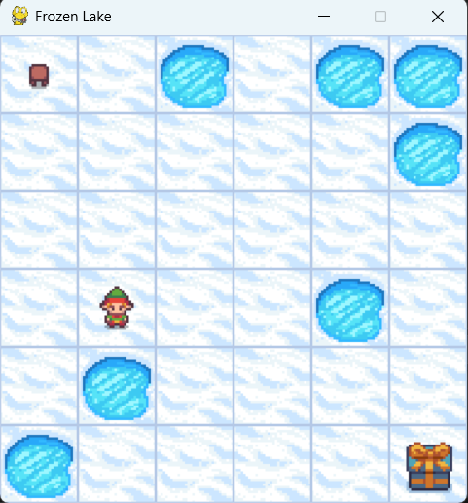
Our Map & Initial Reward Function
The environment is initialized with a sparse binary reward function:
Reward = +1: Only granted upon reaching the Goal.
Reward = 0: Given for any other step (walking on Frozen surface or falling into a Hole).
This sparsity makes learning difficult, necessitating the use of Reward Shaping.

Slide 4

Monte-Carlo (Every Visit)
The Concept (Learn from History):
Monte Carlo agent waits for the entire episode to finish.
It then looks at the episode in reverse (from end to start) to calculate the total Returns (G) for every decision it made along the way.
The Update Rule:
Instead of calculating a simple average of all past returns (Theoretical approach), we use a Constant $α$ update rule:
$$Q\left(S,A\right)=Q\left(S,A\right)+α\left[G−Q\left(S,A\right)\right]$$
Every-Visit: We update the Q-value every time a state is visited in the episode, not just the first time.

Slide 5

SARSA
The Concept (Learn on the Fly):
SARSA updates its knowledge after every single step.
The Name stands for State, Action, Reward, State (next), Action (next) - the exact sequence needed for one update.
The Update Rule:
The agent updates the Q-value using the standard Constant $α$ formula:
$$Q\left(S,A\right)=Q\left(S,A\right)+α\left[R+γQ\left(R^{′},A^{′}\right)−Q\left(S,A\right)\right]$$

Slide 6

The Learning Rate Strategy-Constant Alpha
What is Alpha:
Alpha is the Learning Rate (step size). It determines how much new information overrides old knowledge.
Range: 0 < $α$ < 1
High $α$ Fast learning, but unstable (forgets history too quickly).
Low $α$Stable, but slow convergence.

Slide 7
Standard Shaping Methods
Baseline: Uses the original sparse reward (+1 only at Goal, 0 otherwise). Used as a control group.
Step Cost: Adds a constant penalty (-0.01) per step. This encourages the agent to find the shortest path to the goal to minimize accumulated debt.
Potential-Based Shaping (PBRS):
We used the negative Manhattan Distance to the goal. As the agent gets closer, the reward is positive; if it moves away, it is negative.

Slide 8
Custom 1 - Safety First
Motivation:
In the standard FrozenLake, falling into a hole yields a reward of 0. To the agent, this is technically "not bad" compared to wandering aimlessly.
We wanted to explicitly teach the agent that dying is bad.
Implementation:
We utilized our Wrapper to combine the logic from the previous strategies.
The Key Addition: We added a specific condition for failure. If the agent falls into a hole, we apply a specific Penalty of -0.5.
Advantages:
This strategy solves the conflict between speed and safety. The agent wants to reach the goal fast but is forced to be careful around holes.

Slide 9
Custom 2 - Advanced Guidance
Implementation:
We used our Wrapper to combine all the logic we discussed into one formula.
Potential: To guide the agent toward the goal.
Step Cost (-0.001): To encourage speed.
Hole Penalty (-0.5): If the agent falls, it gets a specific punishment of -0.5.
Formula: Total= Potential + CumulativeStepCost + HolePenalty
Advantages:
This strategy balances efficiency with safety and accelerates learning by turning neutral failures into clear penalties.

Slide 10
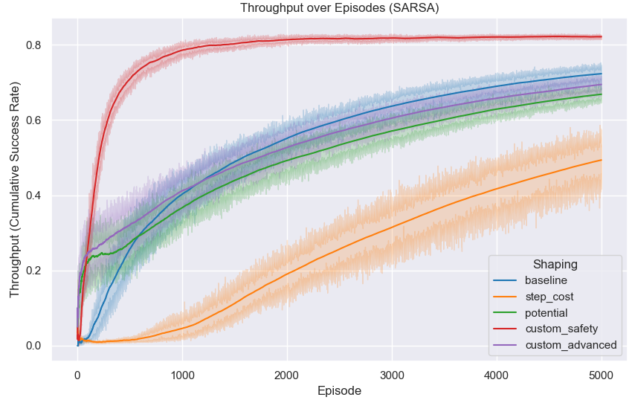
Throughput SARSA

Slide 11
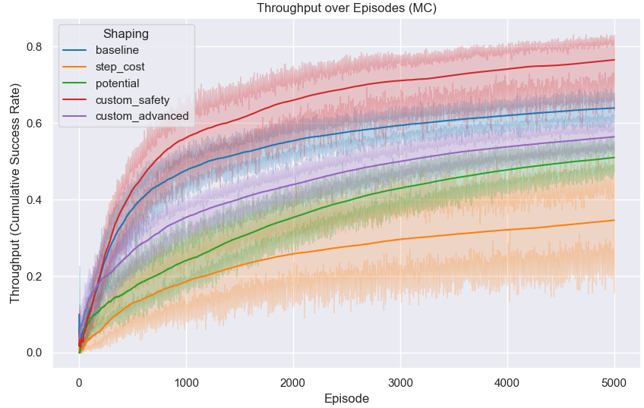
Throughput MC

Slide 12
Results - Throughput (SARSA & MC)
Best Early Learning: "Safety First" (Red line) had the fastest start.
SARSA vs. MC: SARSA learns much faster because it updates every step.
Advanced Strategy: Improved performance but was slower than "Safety First".

Slide 13
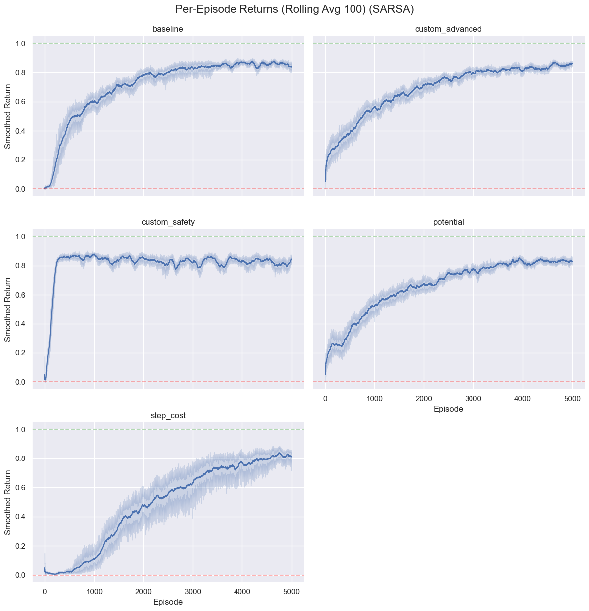
Returns SARSA

Slide 14
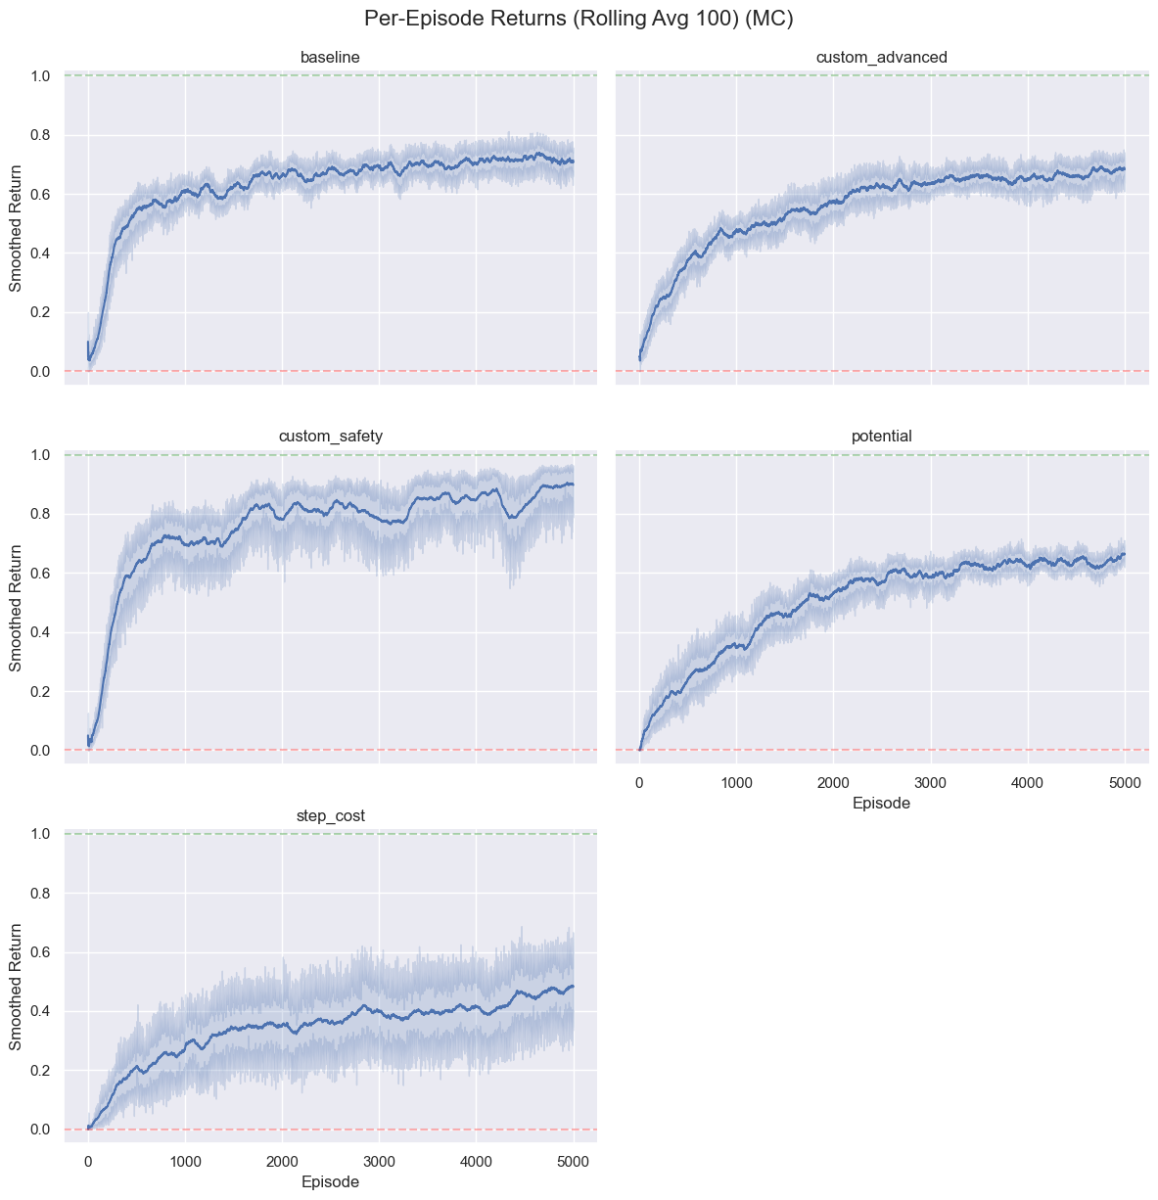
Returns MC

Slide 15
Results - Returns (Total Reward)
Stability: SARSA is more stable and consistent than Monte Carlo.
Fastest Stabilization: "Safety First" reached peak performance quickest.
Failure Case: Step-Cost in MC caused "suicide behaviour" (falling on purpose) to avoid penalties.

Slide 16
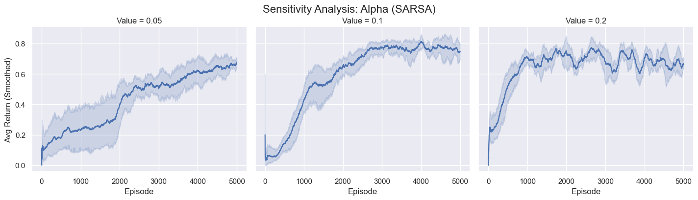
Sensitive SARSA Alpha

Slide 17
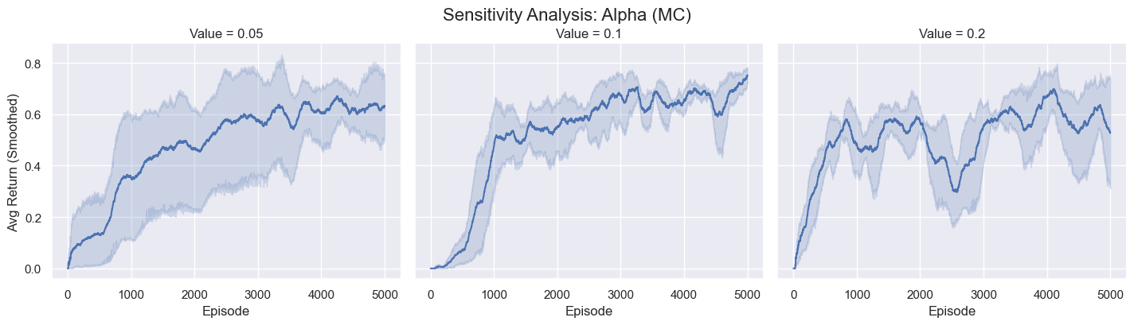
Sensitive MC Alpha

Slide 18
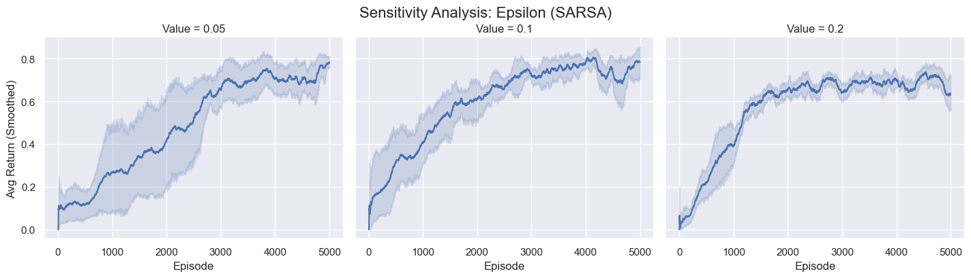
Sensitive SARSA Epsilon

Slide 19
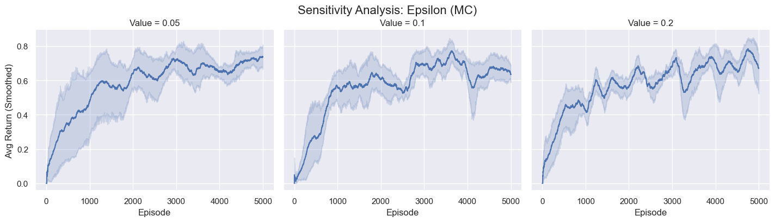
Sensitive MC Epsilon

Slide 20
Results - Sensitivity Analysis
Learning Rate (Alpha):
0.1 (Optimal): Best balance of exploration speed and final stability.
0.05: Too conservative, slow convergence to the goal.
0.2: Too random, excessive exploration degrades final performance.
Exploration Rate (Epsilon):
0.1 (Optimal): Best balance of exploration speed and policy stability.
0.05: Too conservative, results in slow convergence.
0.2: Too random, degrades final performance due to excessive exploration.

Slide 21
Conclusions
Shaping Works: Crucial for speeding up learning in sparse environments.
Safety > Potential: Avoiding death ("Safety First") taught the agent better than seeking the goal.
Algorithm Fit: SARSA benefits more from shaping than MC.
Keep it Simple: Complex hybrid strategies did not beat simple safety rules.

Slide 22
Thank You

